Slide 1
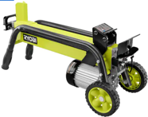
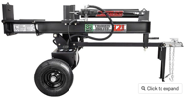
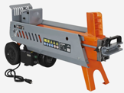
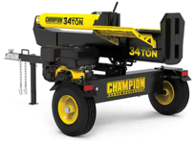
Wood Log Splitter
Firewood is traditionally cut to 16 inches because three pieces at this length equal 48 inches (4 feet), which perfectly fits the standard cord measurement of 4'x4'x8'.
This 16-inch standard became universal because it fits virtually all residential wood stoves, splits and dries more efficiently than longer pieces, and simplifies volume calculations for buying and selling firewood.
Most residential splitters use hydraulic cylinders with approximately 24-inch stroke lengths. The max length of the logs is a bit smaller (usually 20.5-inch).
Larger commercial units that handle longer logs require correspondingly longer frames and heavier construction.
5 tons, electric, $45 on facebook marketplace
22 tons, electric $2,850
9 tons, electric $550
34 tons, gas engine, $1,900

Slide 2

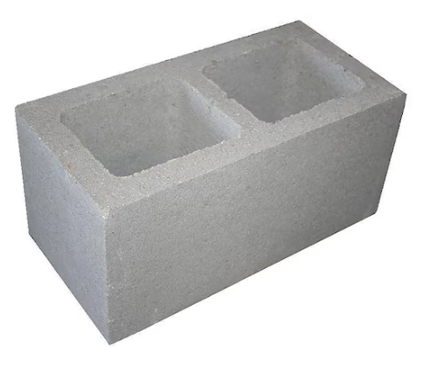
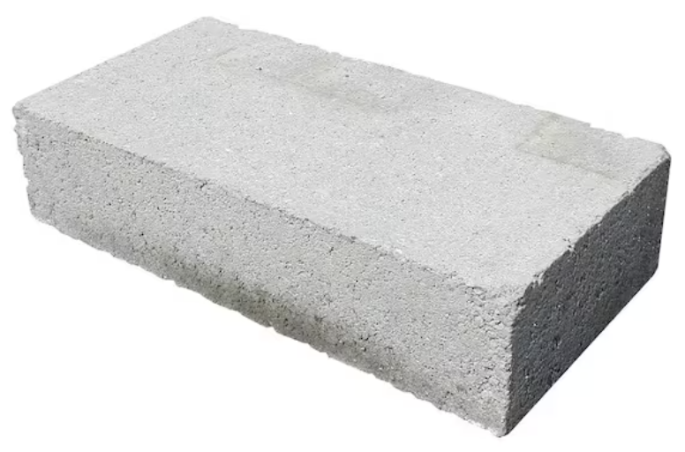
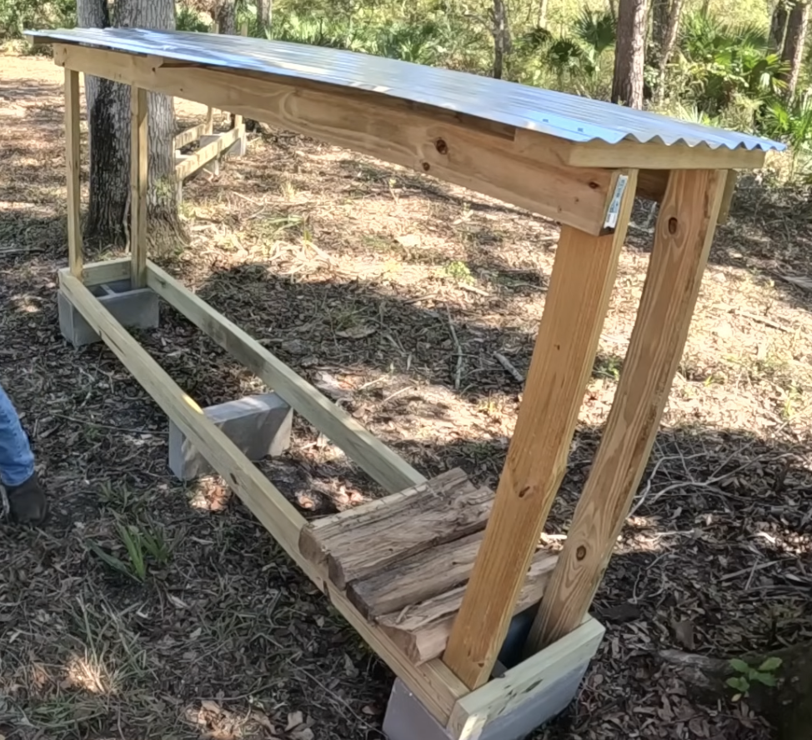
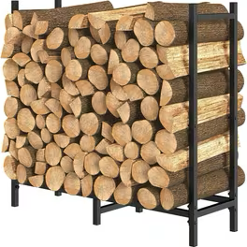
Firewood Rack
Cheap Outdoor Rack
cinder blocks ~$3 each
center block
two 2x4s 4ft length wood pieces
corrugated tin
4FT Heavy-Duty Adjustable Firewood Rack - $20 at Walmart

Slide 3
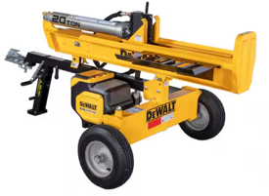
Model | Power | Force (tons) | Log length | Price | Horizontal / Vertical
Champion Power Equipment 27-Ton Splitter | Gas | 27 | 25" | $1.3K
Swisher 22-Ton Electric Log Splitter Eco Split LS22E | Electric | 22 | 25" | $3.3K
Dirty Hand Tools 28-Ton Gas Log Splitter | Gas | 28 | 25" | $1.2K
SuperHandy 20-Ton Electric | Electric | 20 | 25" | $0.9K
NorthStar | gas | 24 | 25" | $1.0K | H + V
Yardmax YU2566 | gas | 25 | 25 | $1.0K
Yardmax Gas Log Splitter 32 Ton 2-Way | gas | 32 | 26.5" | $1.7K
CountyLine 25-Ton Log Splitter | gas | 25 | 26" | $1.7K | H + V
DeWalt FLEXVOLT Max 20-Ton 60V Cordless Battery Powered Log Splitter Kit | battery 60V | 20 | 25" | $2.2K
Ramsplitter 20-Ton Electric (Model H20-4) | Electric 25A | 20 | 26" | $2.1K | HV20-4 : H + V
NorthStar Horizontal/Vertical Log Splitter | gas | 24 | 25" | $1.7K | H+V
Oregon 25-Ton 208cc Briggs & Stratton Horizontal / Vertical Log Splitter OR25TBS-1 | gas | 25 | 25.5" | $1.6K

Slide 4
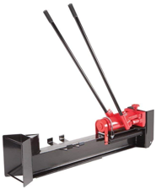
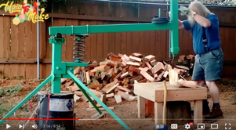
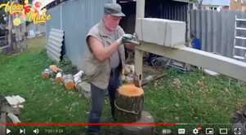
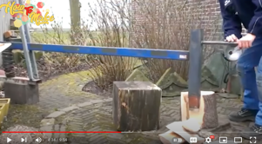
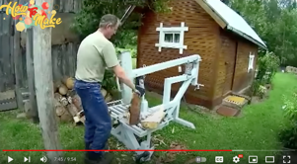

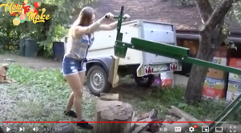
Maunual Firewood Splitter
https://www.youtube.com/watch?v=7txUWFFHkBc
https://www.youtube.com/watch?v=wd_E9VhSfSg
10 Ton Horizontal Log Splitter Wood Cutter Manual Hydraulic 2 Speed
.. https://www.amazon.com/dp/B006ZBCB3M

Slide 5
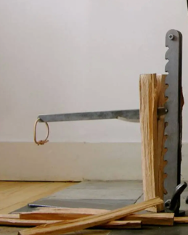
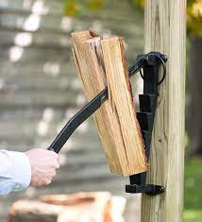
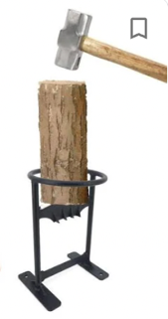

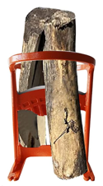
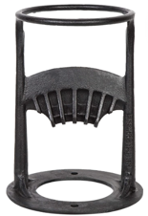
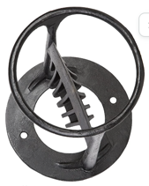
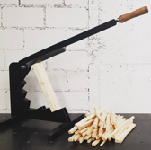

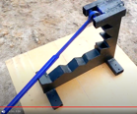
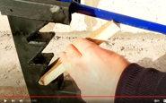
Firewood Kindling Splitter
The Beaver Lever Kindling Cutter
Stikkan Softwood Kindling Splitter
Kindling Cracker Wood Splitter for Firewood
https://www.youtube.com/watch?v=HGLJjR5frtc
https://www.youtube.com/watch?v=HGLJjR5frtc
https://www.youtube.com/watch?v=ZI6cwHRAu8U
Firewood Kindling Splitter

Slide 6
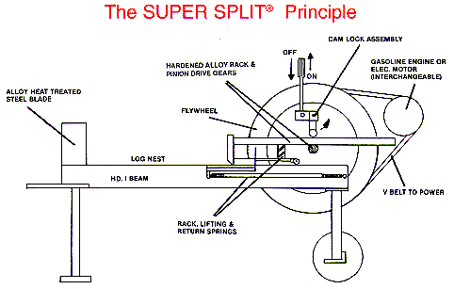
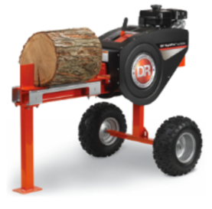
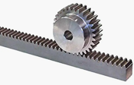
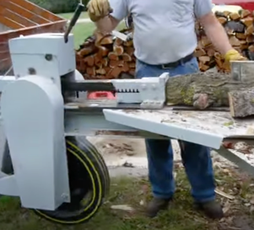
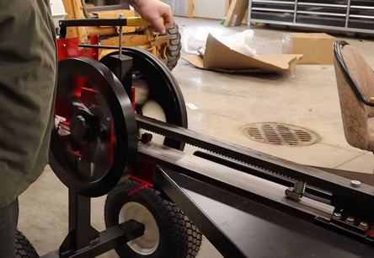
Fly Wheel Log Splitter = kinetic log splitter
Google for vintage fly wheel log splitter
https://www.youtube.com/watch?v=hlAerawLdYU
rack and pinion gear
Motor (gas or electric) rotates massive flywheel(s)
The shaft (axle) of this wheel has a (pinion) gear
A moveable rack also has gear.
It is pressed to the shaft gear using a cam lock
The rotating gear pushes the rack in a short burst, then disenges
Several burst may be needed to split the wood

